Slide 1
Software construction lab :12 exception handling & fault tolerance

Slide 2
Outcomes:
Smooth Sailing: Exception handling keeps your code sailing smoothly, catching errors like a safety net.
Graceful Recovery: When the unexpected happens, it's like having a plan B – your code gracefully recovers without crashing the entire show.
User-Friendly: Fault tolerance ensures a user-friendly experience, minimizing disruptions and glitches in the software performance.
Continuity Assurance: Even if a component misbehaves, fault tolerance ensures that the entire system doesn't throw in the towel.
Reliability Booster: Exception handling and fault tolerance work hand in hand, boosting the reliability of your software in the face of unforeseen challenges.
Future-Proofing: By anticipating and handling exceptions, and tolerating faults, your code becomes resilient and ready to face the uncertainties of the digital frontier.

Slide 3
Introduction: exception handling
Exception handling and fault tolerance are like safety nets in the world of software development.
In the coding world, exceptions are unexpected events or errors that can happen, like a file not being found or a network connection failing. Exception handling is like having a plan in place to gracefully deal with these surprises. Instead of letting your program crash and burn like a something gone wrong, you catch the exception and take appropriate action.

Slide 4
Fault tolerance:
In software, fault tolerance is about building systems that can keep going even when something unexpected happens, like a server going down. It's like having a backup plan in place. Just like a good GPS can reroute you around traffic, a fault-tolerant system can adapt and continue functioning despite hiccups.

Slide 5
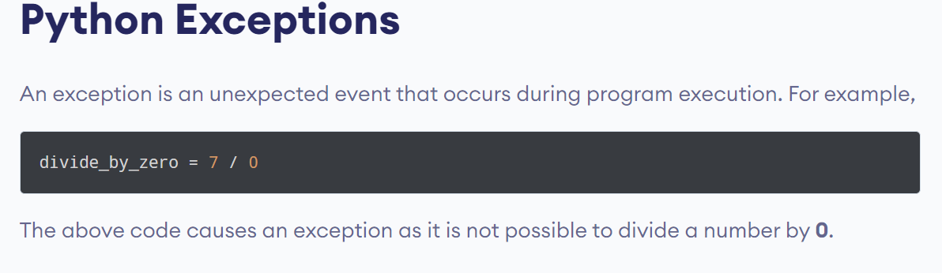
Python exceptions:

Slide 6
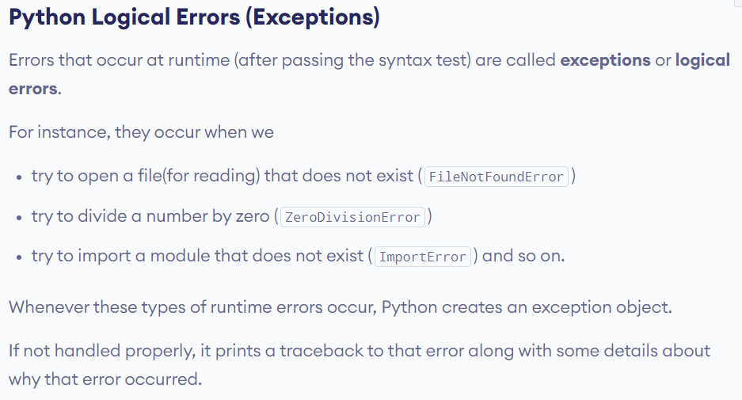
Cases:

Slide 7
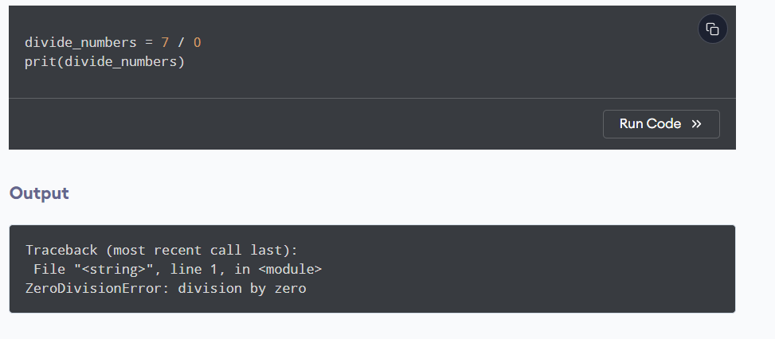
How python treat these exceptions:

Slide 8
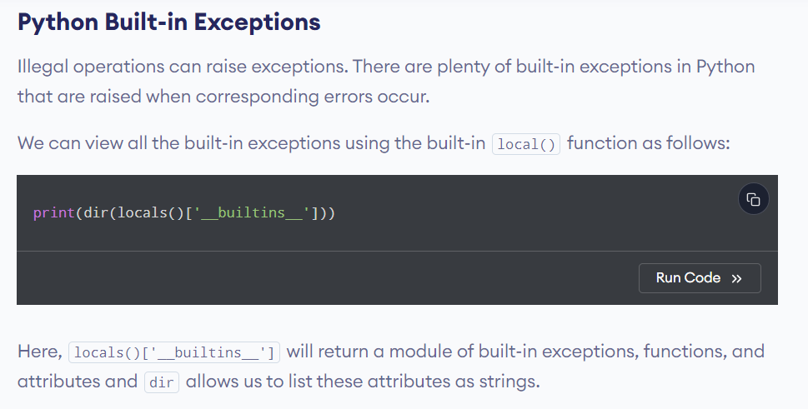
How to explore python built-in exception:

Slide 9
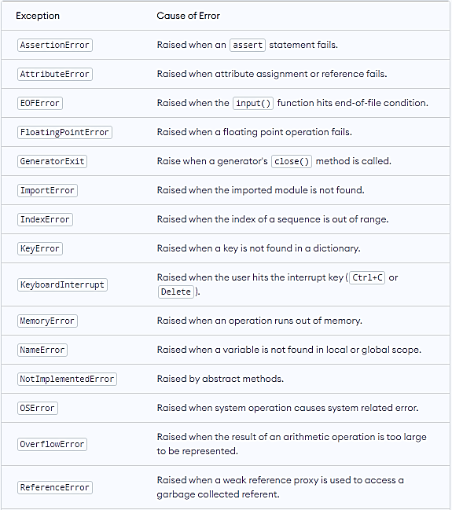
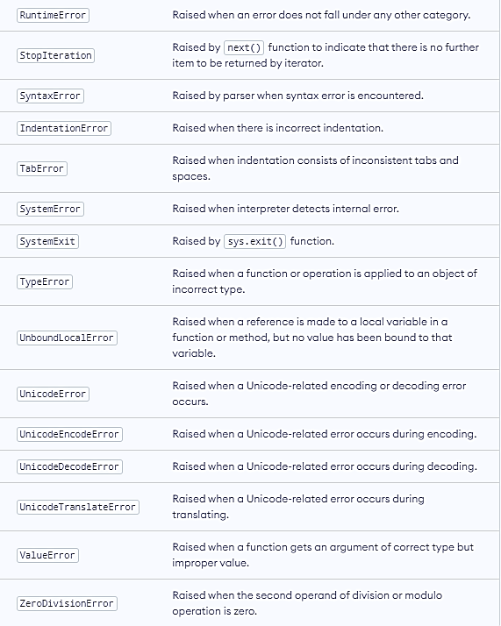
Some built in exceptions in python

Slide 10
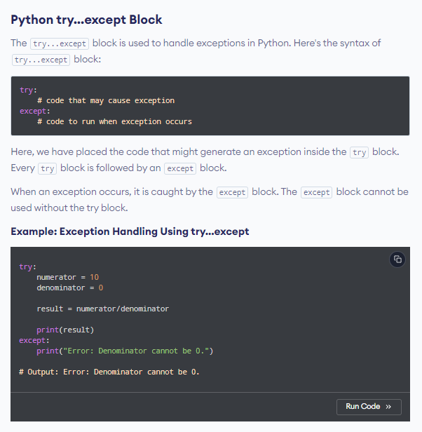
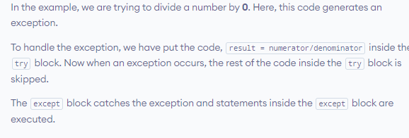

Python exception handling

Slide 11
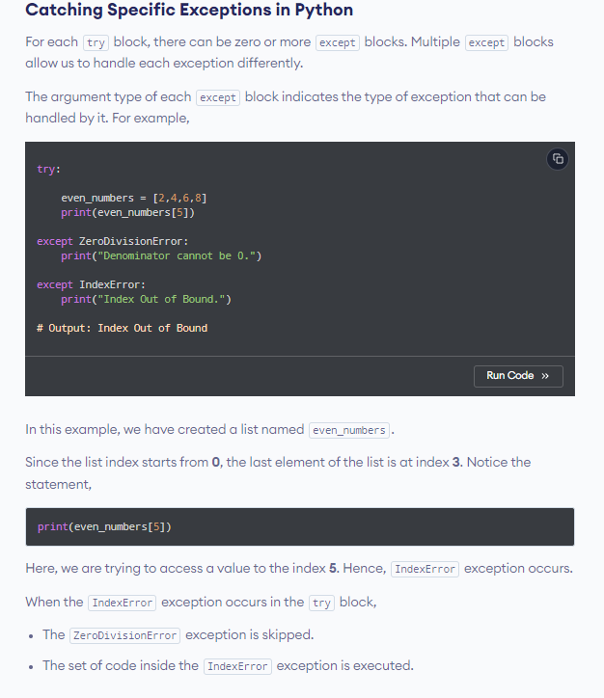
Handling multiple exceptions:

Slide 12
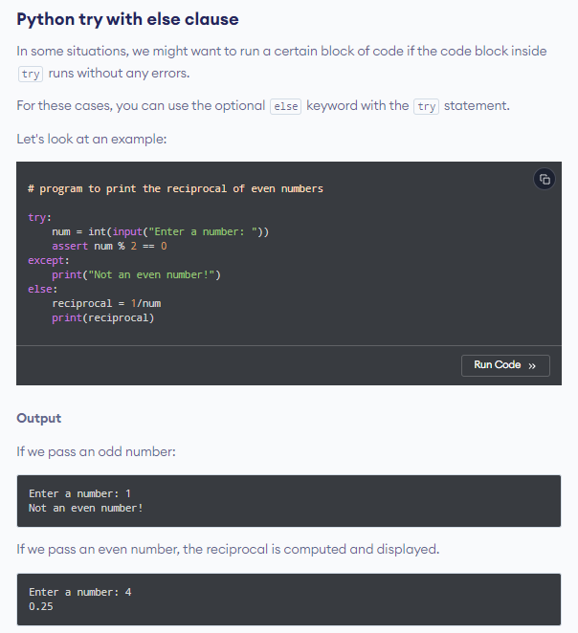
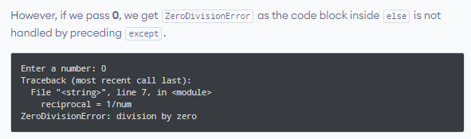
Try with else block

Slide 13
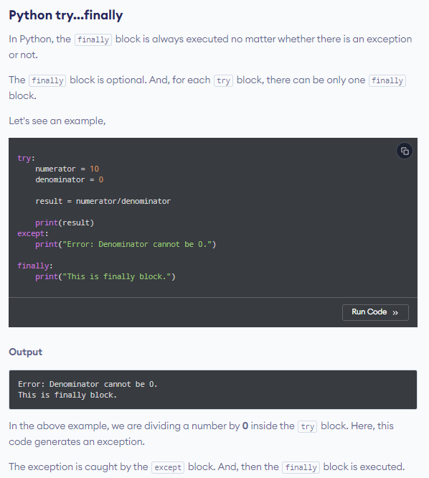
Python try… finally

Slide 14
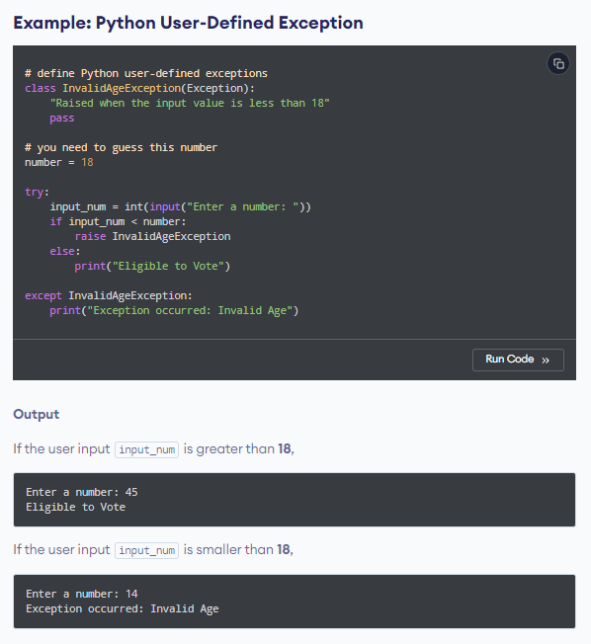
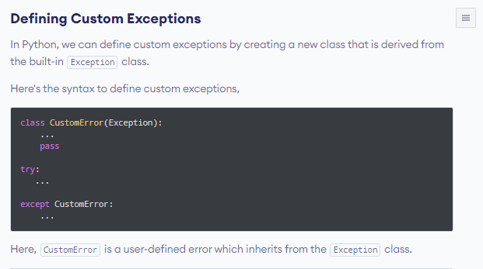
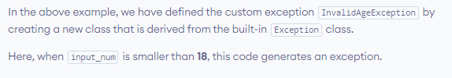
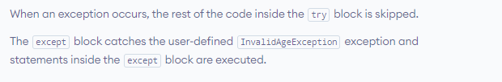
Custom exception:

Slide 15
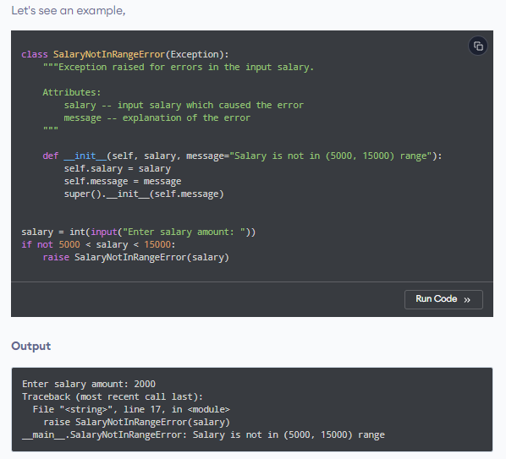
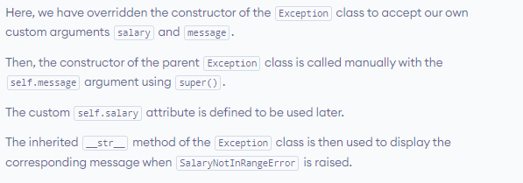
Another example:

Slide 16
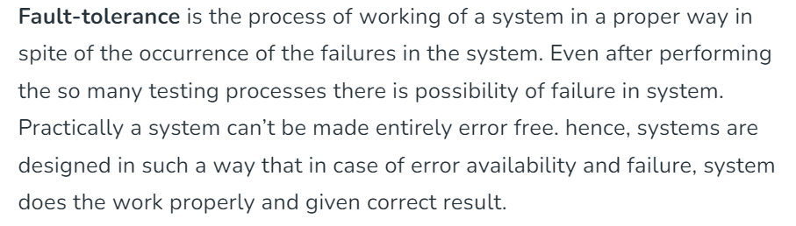
Fault tolerance:

Slide 17
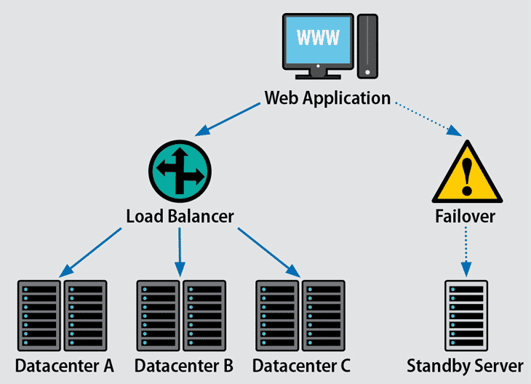
Fault tolerance representation:

Slide 18
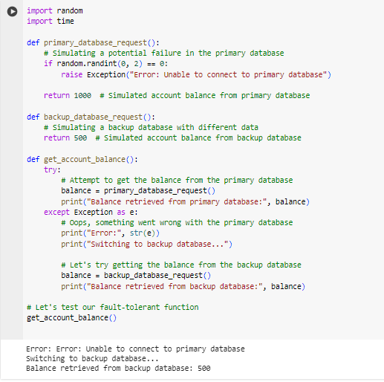
Fault tolerance example:
Notes:
import random
import time
def primary_database_request():
# Simulating a potential failure in the primary database
if random.randint(0, 2) == 0:
raise Exception("Error: Unable to connect to primary database")
return 1000 # Simulated account balance from primary database
def backup_database_request():
# Simulating a backup database with different data
return 500 # Simulated account balance from backup database
def get_account_balance():
try:
# Attempt to get the balance from the primary database
balance = primary_database_request()
print("Balance retrieved from primary database:", balance)
except Exception as e:
# Oops, something went wrong with the primary database
print("Error:", str(e))
print("Switching to backup database...")
# Let's try getting the balance from the backup database
balance = backup_database_request()
print("Balance retrieved from backup database:", balance)
# Let's test our fault-tolerant function
get_account_balance()

Slide 19
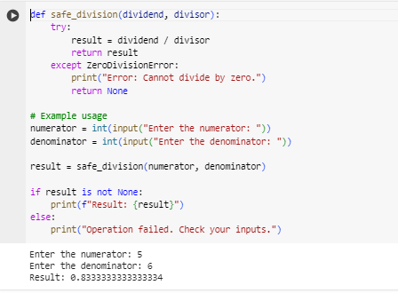
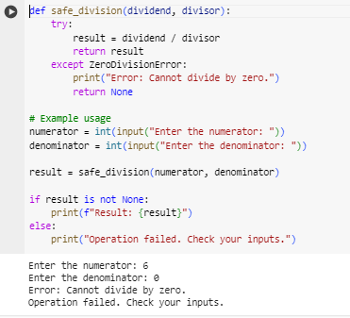

Another example:
In normal condition:
In abnormal condition:

Slide 20
Tasks:
Task: Safe Calculator Operation
Write a Python program for a basic calculator that takes two numbers and an operation as input. Implement exception handling to ensure that division by zero is handled gracefully. If the user attempts to divide by zero, print an error message and prompt for new inputs.
Task: File Copy with Retry
Create a Python script that copies the contents of one file to another. Implement a retry mechanism in case the file reading or writing fails due to a temporary issue (e.g., file in use by another process). Allow the user to specify the number of retry attempts.

Slide 21
Tasks:
Task: Web Scraper with Error Handling
Develop a simple web scraper using a library like BeautifulSoup in Python. Implement exception handling to deal with common issues such as network errors, missing HTML elements, or changes in the website structure. Log relevant error messages for debugging purposes.
Task: Database Connection Retry
Write a Python program that connects to a database and performs a basic query. Implement a retry mechanism for the database connection, considering scenarios like network issues or temporary unavailability of the database server. Allow the user to set the maximum number of retry attempts.
Task: Custom Exception Class
Create a Python program that simulates a banking system. Design a custom exception class, let's say InsufficientFundsError, and use it to handle situations where a user tries to withdraw more money than their account balance. Ensure that the program raises and catches this custom exception appropriately.

